Slide 1

Library Management System
Under the Guidance of: Miss Lovely Verma & Mr. Vinay Kumar Sharma
Name – Priya Gupta
Course - M.Sc.(CS) 2022-23
Roll no. -

Slide 2
Overview of Presentation
Introduction
Objective
Technology used
Modules
Working Images & Flow
Database Design
Advantages
Future Scope
Conclusion & Resource Links

Slide 3

Introduction
The Library Management System is an innovative solution designed to enhance the efficiency and accessibility of library services. In today's digital age, libraries remain a cornerstone of education and knowledge dissemination. This project aims to bridge the gap between traditional library services and modern technology, providing administrators and candidates with a seamless platform for managing and accessing resources.

Slide 4
Objective
The primary objectives of the Library Management Project include:
Efficient Book Management: Simplifying the process of adding, updating, and deleting book records for administrators, using an intuitive user interface.
Candidate Convenience: Enabling candidates to easily browse the library's collection, check availability, and request books online.
Streamlined Record-Keeping: Centralizing book and student records to ensure accurate and organized data management.

Slide 5
Technology Used
The project leverages a combination of technologies to deliver a comprehensive library management solution:
Backend Language: Java, a versatile and widely-used programming language, serves as the backbone for the project's functionality.
Frontend Framework: HTML , CSS and AngularJS, a powerful frontend framework, facilitates the creation of dynamic and user-friendly interfaces.
Database: PostgreSQL, a robust and open-source relational database management system, stores book and student information securely.
APIs: RESTful APIs have been implemented to enable seamless communication between the frontend and backend components.

Slide 6
Modules
The Library Management Project is divided into several interconnected modules:
Admin Module: Administrators have access to functionalities such as adding new books, updating existing records, managing student data, and overseeing borrowing activities.
Candidate Module: Candidates can search for books using various criteria, view availability, and request books for borrowing.
Database Module: This module interacts with the PostgreSQL database, managing data storage and retrieval.
API Module: The RESTful API module enables data communication between the frontend and backend components.

Slide 7
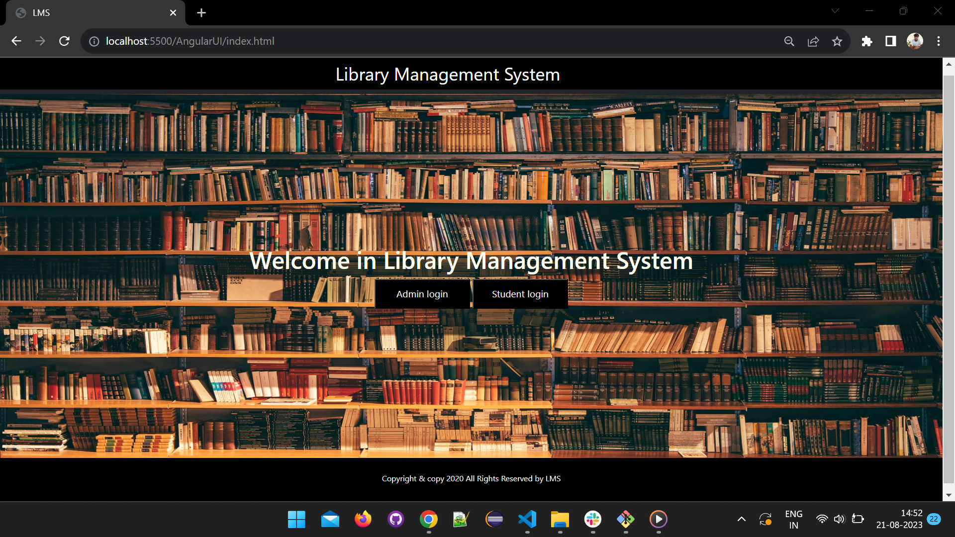
Working Images

Slide 8
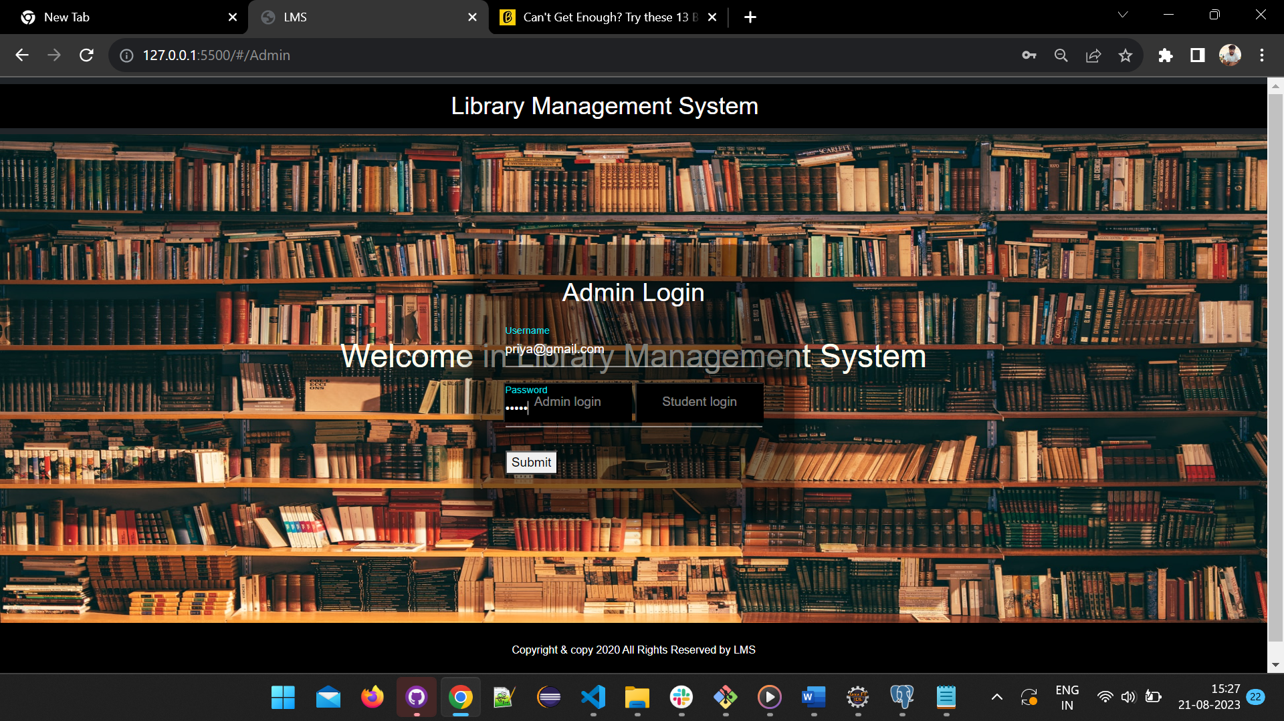

Slide 9
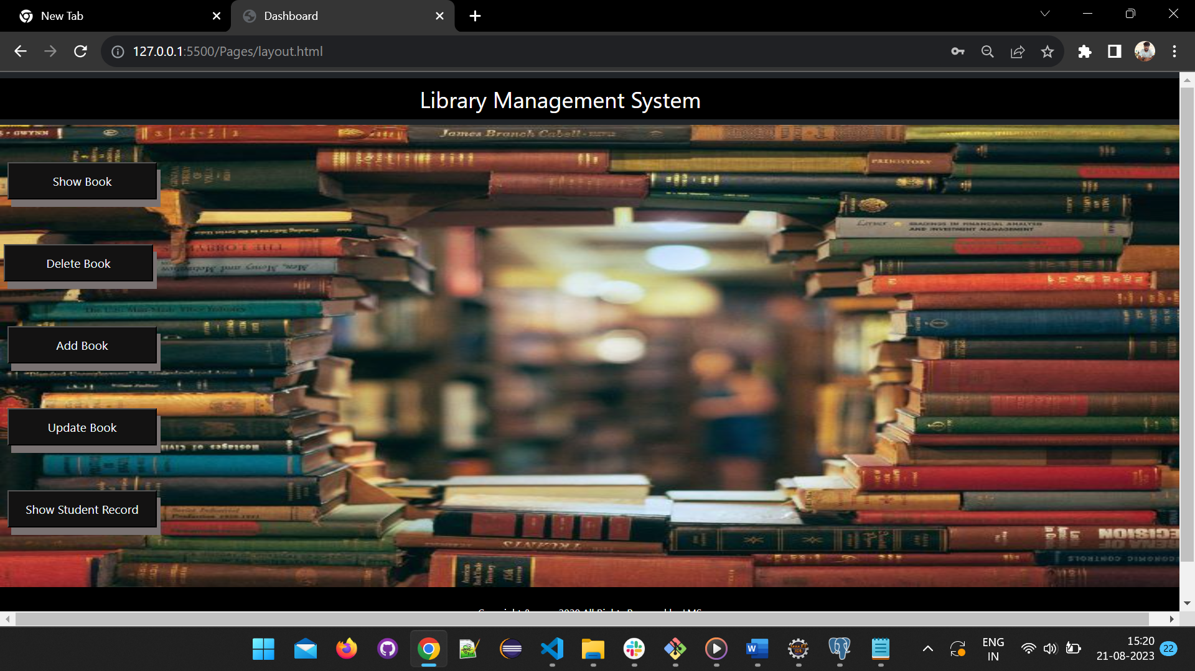

Slide 10
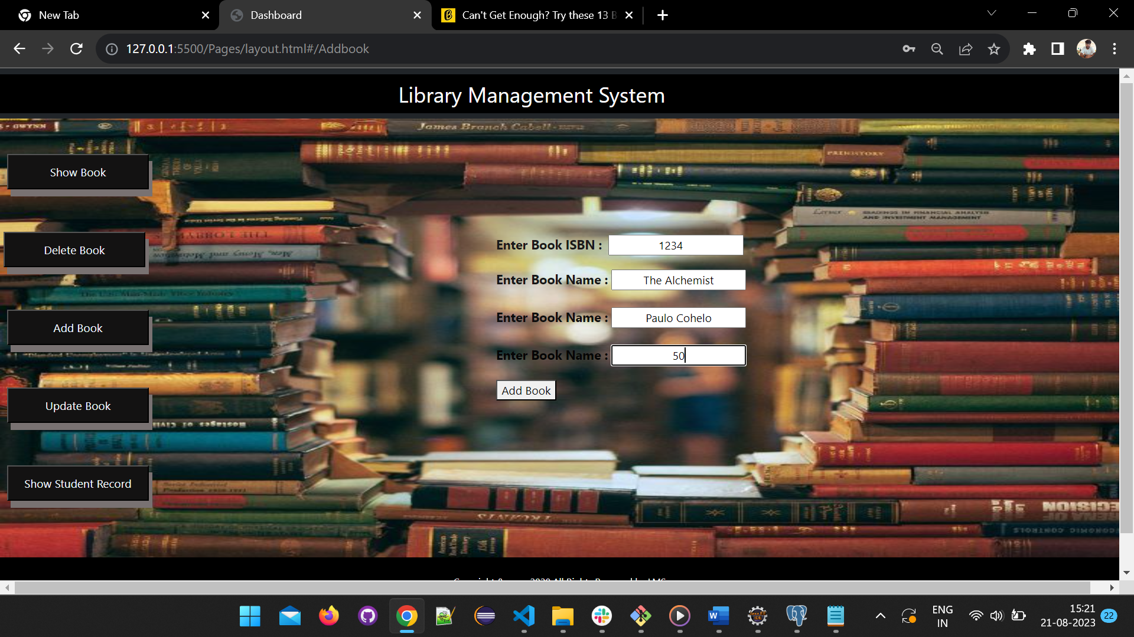

Slide 11
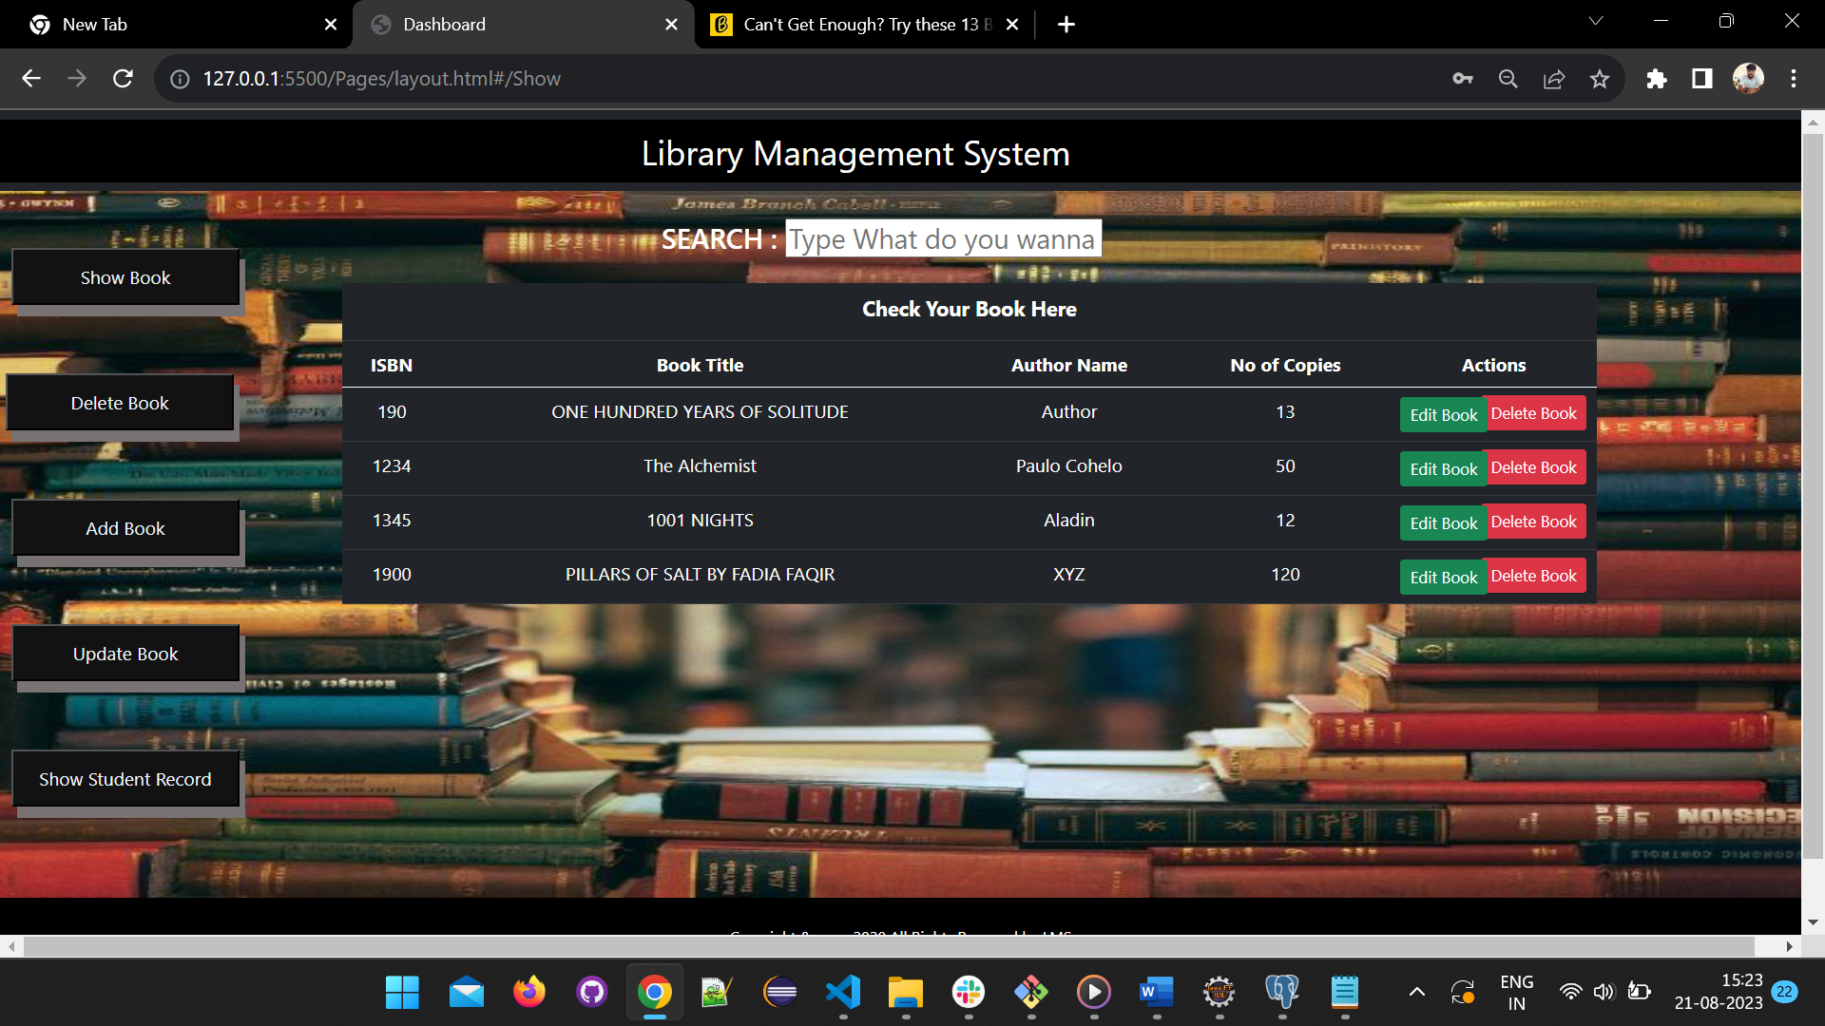

Slide 12
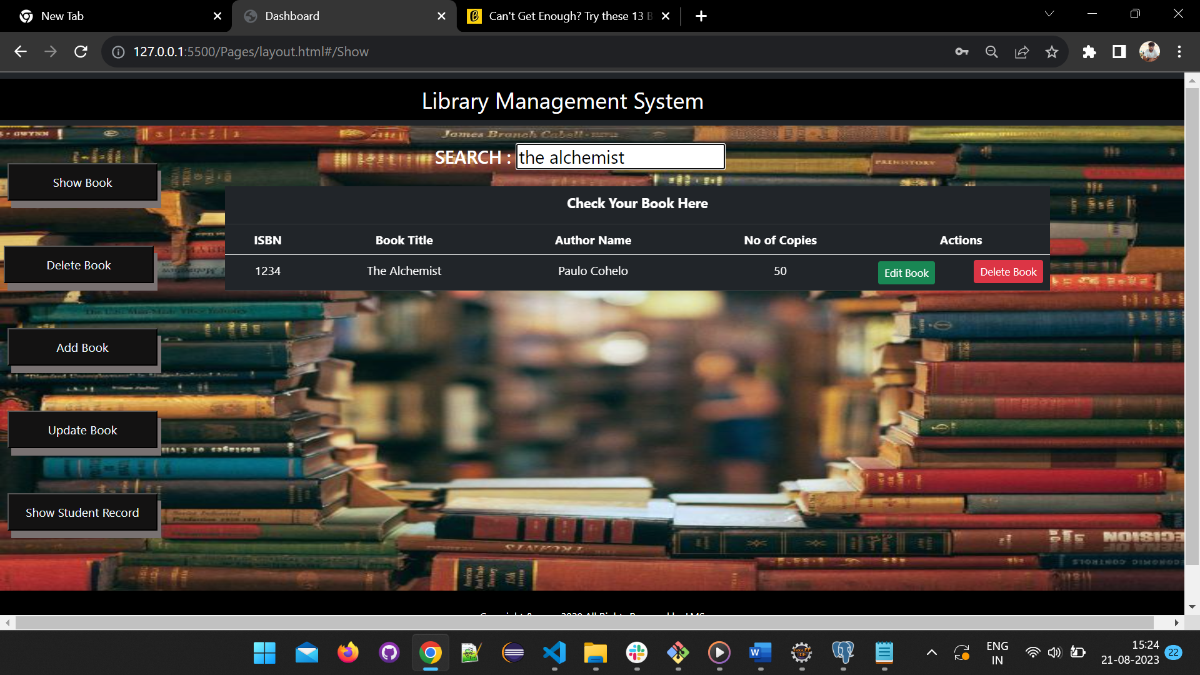

Slide 13
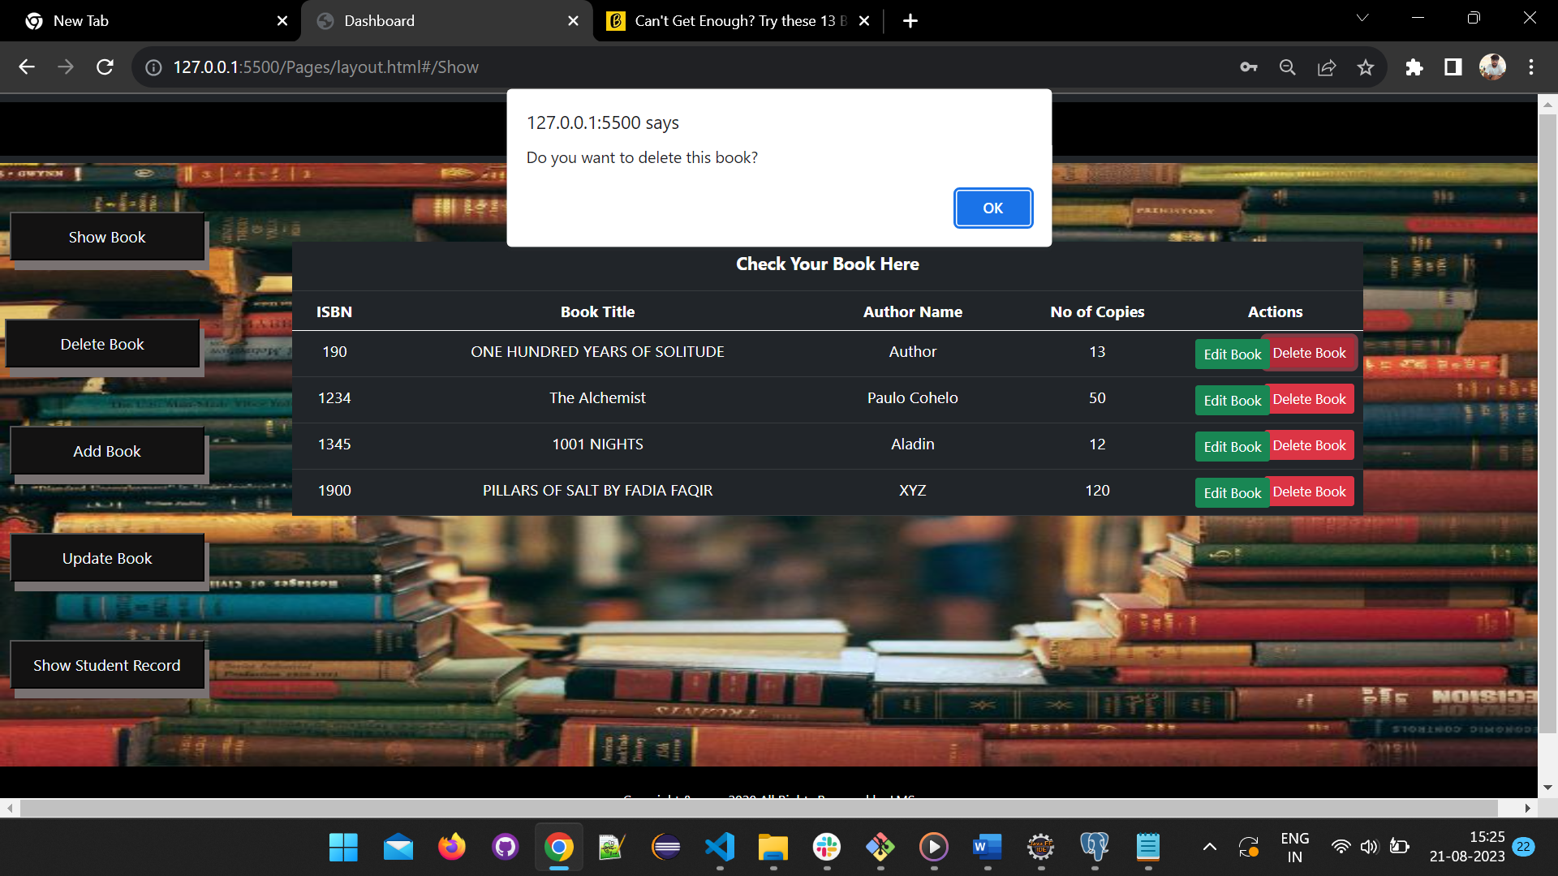

Slide 14
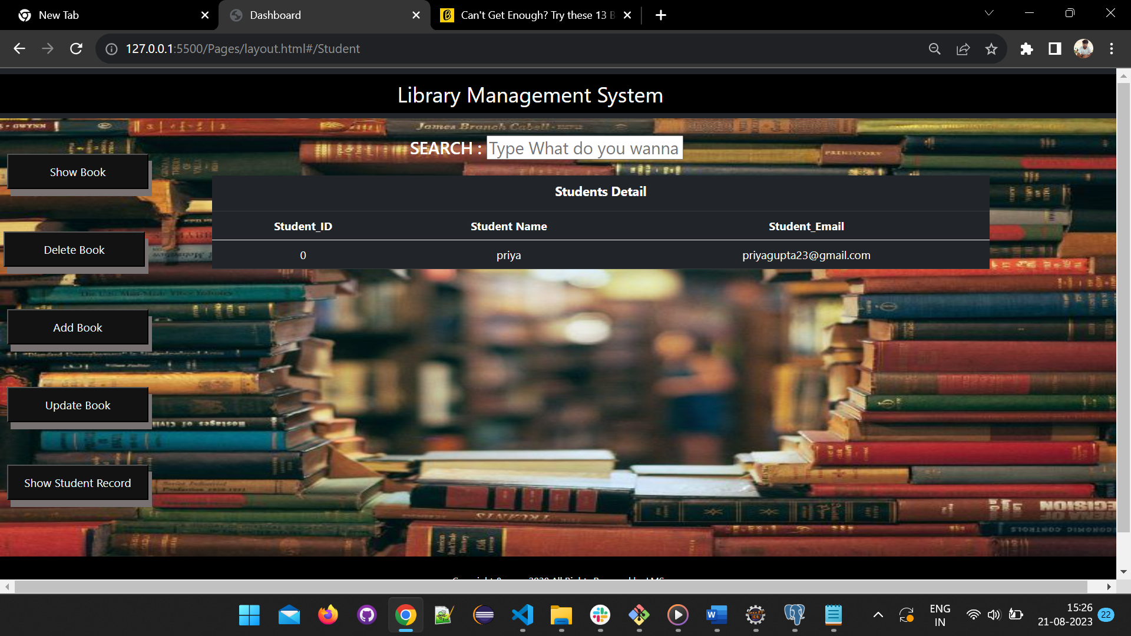

Slide 15
Working Flow
The Library Management application offers a user-friendly experience for both administrators and candidates:
Administrator Workflow: After logging in, administrators can easily navigate to the "Manage Books" section, where they can add, update, or delete book records. They can also oversee student records and track borrowing activities.
Candidate Workflow: Candidates log in and access the library's collection. They can search for books using keywords, titles, or authors. Availability status is displayed, and candidates can place requests for books they wish to borrow.

Slide 16
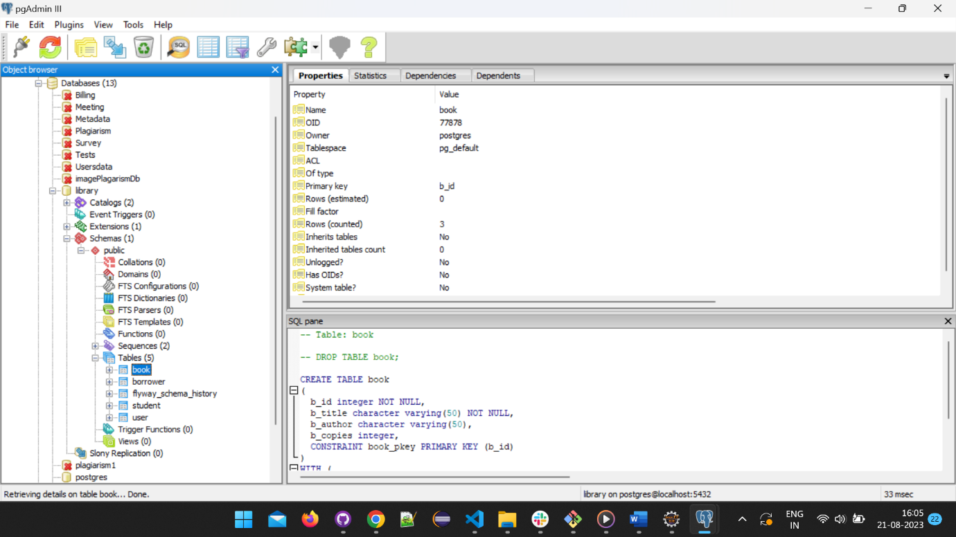
Database Design
This schema outlines the structure of the four tables in your database: Book, Student, User, and Borrower. Each table's columns, data types, and brief descriptions are provided to give an overview of the schema design.

Slide 17
Table Book :
Column | Data Type | Description
b_id (PK) | SERIAL | Book ID (Primary Key)
b_title | VARCHAR(50) | Book Title
b_author | VARCHAR(50) | Author of the Book
b_copies | INT | Number of Copies Available
User Table:
Column | Data Type | Description
id (PK) | SERIAL | User ID (Primary Key)
Full name | VARCHAR(50) | User’s Full Name
isAdmin | Boolean | Admin Status
Password | VARCHAR(50) | User’s Password
username | VARCHAR(50) | User’s Email

Slide 18
Database Schema
Student Table :
Column | Data Type | Description
s_id (PK) | SERIAL | Student ID (Primary Key)
S_name | VARCHAR(50) | Student Name
S_email | VARCHAR(50) | Student Email
S_pass | VARCHAR(50) | Student Password
Borrower Table:
Column | Data Type | Description
Borrower_Id | INT | Borrower ID (Primary Key)
Book_Id | INT | Book ID (Foreign Key)
Borrowed_From | Boolean | Date Borrowed
Borrowed_TO | DATE | Due Date
Actual_Return_Date | DATE | Actual Return Date

Slide 19
Advantages
Efficiency: Automated book management reduces manual effort, allowing administrators to focus on more strategic tasks.
Accessibility: Candidates can browse the library's collection from anywhere, at any time, enhancing user experience.
Accuracy: Centralized data storage minimizes errors in record-keeping, ensuring reliable information for both administrators and candidates.

Slide 20
Future Scope
While the current implementation is robust, there are exciting opportunities for future expansion:
User Profiles: Introducing candidate profiles with borrowing history and preferences for personalized experiences.
Notifications: Implementing automated notifications for due dates, book availability, and account updates.
Analytics: Incorporating data analytics to generate insights into borrowing patterns, popular genres, and more.

Slide 21
Conclusion & Resources Used
The Library Management Project underscores the importance of innovation in traditional institutions. By combining technology with library services, this project not only improves efficiency but also enriches the experience of candidates and administrators. As technology continues to evolve, there is ample room for growth and enhancement in this sector.
For more information on the technologies used in this project, please refer to the following resources:
Java Programming Guide
AngularJS Documentation
PostgreSQL Documentation
RESTful API Design Principles

Slide 22
THANK YOU!

